Slide 1
AC-II
UNIT-V SPECIAL FUNCTION ICs
Timer IC 555, IC Voltage regulators: Three terminal fixed and Adjustable voltage regulators, IC 723 general purpose regulator, Monolithic switching regulator.

Slide 2
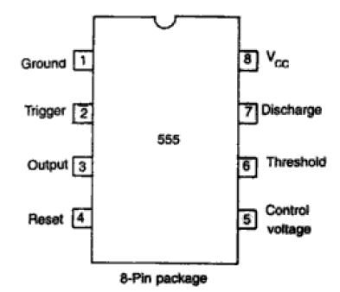
555 TIMER
It is a highly stable device for generating accurate time delay or oscillation
Applications:
Oscillator
Pulse generator
Ramp and square wave
generator
Monoshot multivibrator
Traffic light control
Voltage monitor

Slide 3
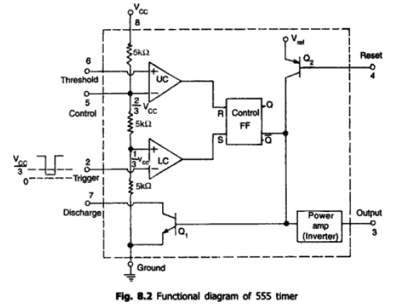

Slide 4
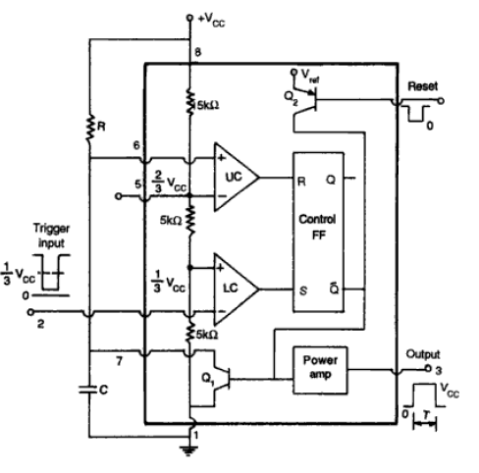
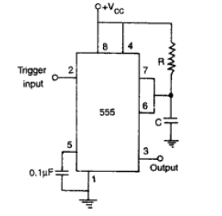
Monostable Multivibrator

Slide 5
Function
In standby state, O/p = Low
If negative trigger input is applied,
LC --- o/p = 1; S=1, R=0; then Q=1;Q’ = 0
Then o/p = HIGH
At this time Capacitor starts charging with time constant RC
If the Capacitor Voltage reaches (2/3)*VCC,
UC ---o/p = 1; S=0, R=1; then Q=0;Q’ = 1
Then o/p = LOW

Slide 6
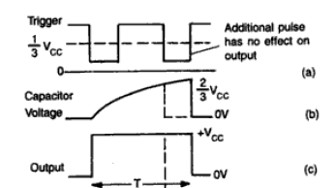
Waveforms

Slide 7
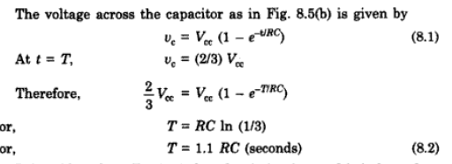
Analysis

Slide 8
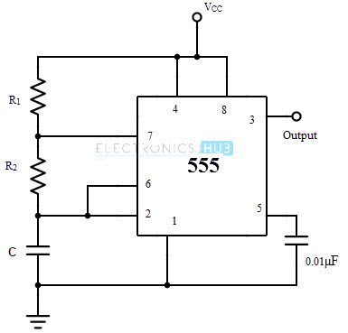
Astable Multivibrator using IC555

Slide 9
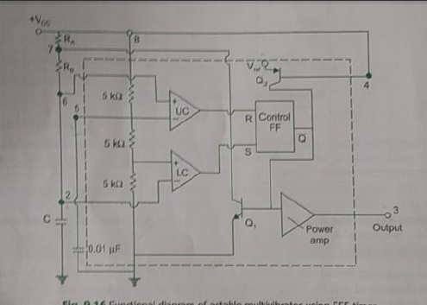
Functional Diagram of Astable Multivibrator

Slide 10
Voltage Regulators - Introduction
Batteries are often shown on a schematic diagram as the source of DC voltage but usually the actual DC voltage source is a power supply.
There are many types of power supply. Most are designed to convert high voltage AC mains electricity to a suitable low voltage supply for electronics circuits and other devices.
A more reliable method of obtaining DC power is to transform, rectify, filter and regulate an AC line voltage.
A power supply can by broken down into a series of blocks, each of which performs a particular function.

Slide 11
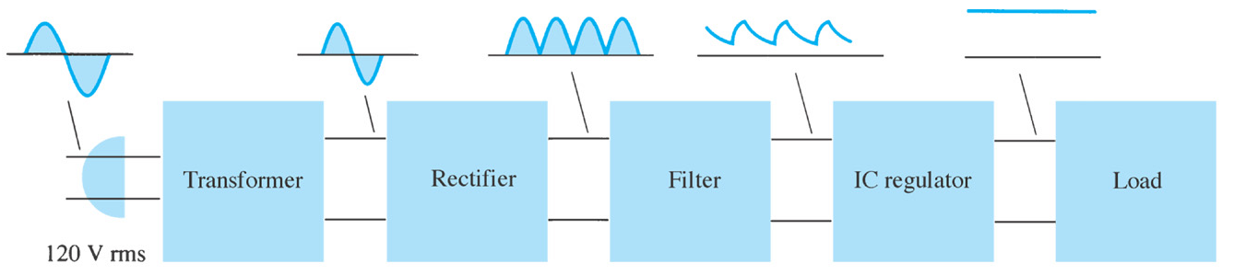
Introduction
Power supply: a group of circuits that convert the standard ac voltage (120 V, 60 Hz) provided by the wall outlet to constant dc voltage
Transformer : a device that step up or step down the ac voltage provided by the wall outlet to a desired amplitude through the action of a magnetic field

Slide 12
Introduction
Rectifier: a diode circuits that converts the ac input voltage to a pulsating dc voltage
The pulsating dc voltage is only suitable to be used as a battery charger, but not good enough to be used as a dc power supply in a radio, stereo system, computer and so on.

Slide 13
Introduction
There are two basic types of rectifier circuits:
Half-wave rectifier
Full-wave rectifier - Center-tapped & Bridge full-wave rectifier
In summary, a full-wave rectified signal has less ripple than a half-wave rectified signal and is thus better to apply to a filter.

Slide 14
Introduction
Filter: a circuit used to reduce the fluctuation in the rectified output voltage or ripple. This provides a steadier dc voltage.
Regulator: a circuit used to produces a constant dc output voltage by reducing the ripple to negligible amount. One part of power supply.

Slide 15
Voltage Regulation
Two basic categories of voltage regulation are:
line regulation
load regulation
The purpose of line regulation is to maintain a nearly constant output voltage when the input voltage varies.
The purpose of load regulation is to maintain a nearly constant output voltage when the load varies

Slide 16
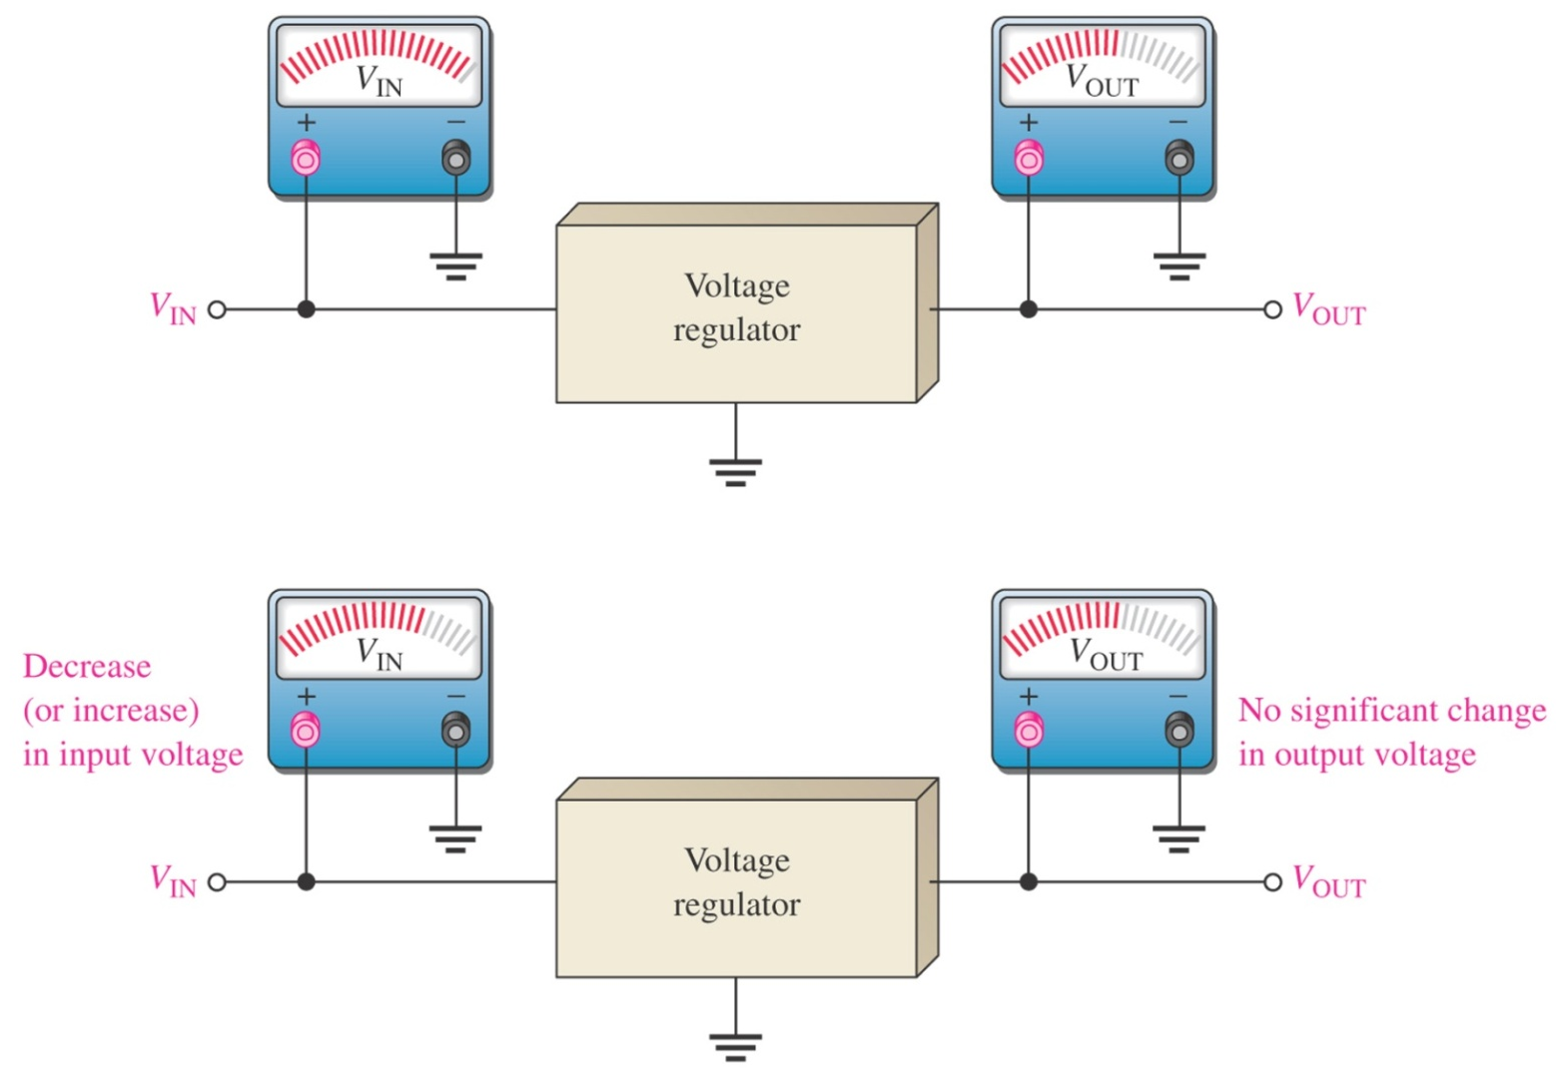
Line Regulation
Line regulation: A change in input (line) voltage does not significantly affect the output voltage of a regulator (within certain limits)

Slide 17
Line Regulation
Line regulation can be defined as the percentage change in the output voltage for a given change in the input voltage.
Δ means “a change in”
Line regulation can be calculated using the following formula:

Slide 18
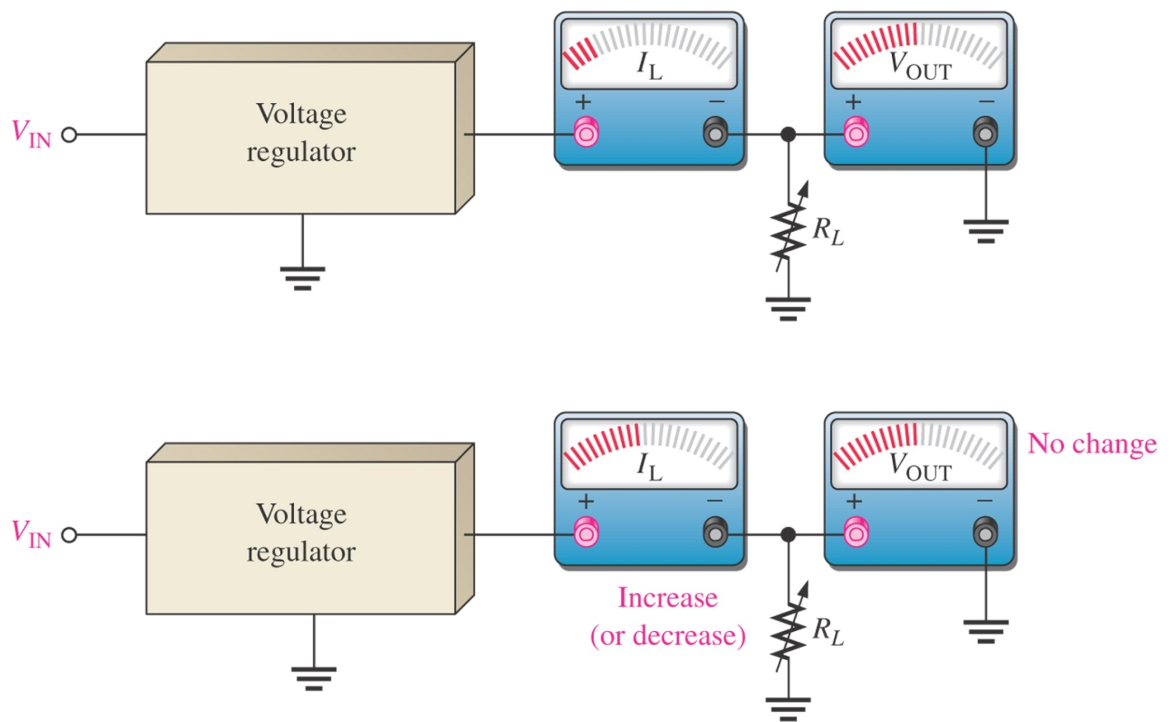
Load Regulation
Load regulation: A change in load current (due to a varying R_{L}) has practically no effect on the output voltage of a regulator (within certain limits)

Slide 19
Load Regulation
Load regulation can be defined as the percentage change in the output voltage from no-load (NL) to full-load (FL).
Where:
V_{NL} = the no-load output voltage
V_{FL} = the full-load output voltage

Slide 20
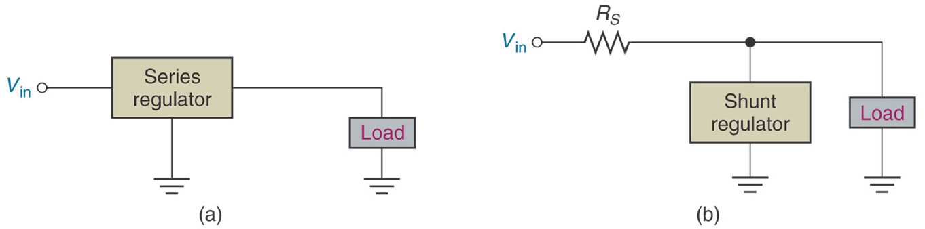
Types of Regulator
Fundamental classes of voltage regulators are linear regulators and switching regulators.
Two basic types of linear regulator are the series regulator and the shunt regulator .
The series regulator is connected in series with the load and the shunt regulator is connected in parallel with the load.

Slide 21
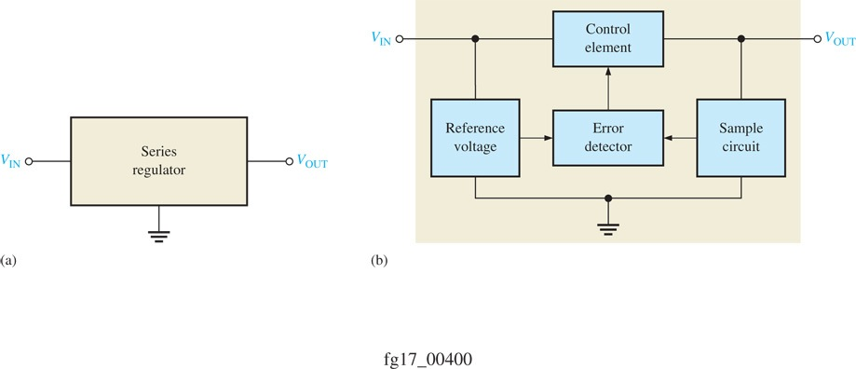
Series Regulator Circuit
Control element in series with load between input and output.
Output sample circuit senses a change in output voltage.
Error detector compares sample voltage with reference voltage → causes control element to compensate in order to maintain a constant output voltage.

Slide 22
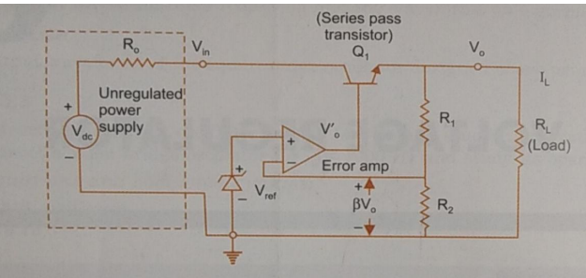

Op-Amp Series Regulator

Slide 23
Op-Amp Series Regulator
The resistor R₁ and R₂ sense a change in the output voltage and provide a feedback voltage.
The error detector compares the feedback voltage with a Zener diode reference voltage.
The resulting difference voltage causes the transistor Q₁ controls the conduction to compensate the variation of the output voltage.
The output voltage will be maintained at a constant value of:

Slide 24
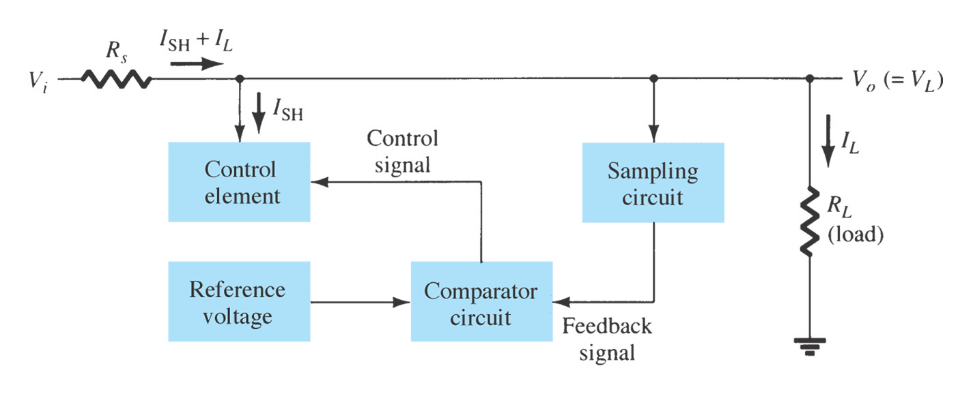
Shunt Regulator Circuit
The unregulated input voltage provides current to the load.
Some of the current is pulled away by the control element.
If the load voltage tries to change due to a change in the load resistance, the sampling circuit provides a feedback signal to a comparator.
The resulting difference voltage then provides a control signal to vary the amount of the current shunted away from the load to maintain the regulated output voltage across the load.

Slide 25
IC Voltage Regulators
Regulation circuits in integrated circuit form are widely used.
These are generally three terminal devices that provide a positive or negative output.
Some types have variable voltage outputs.
A typical 78XX series voltage regulator is used for positive voltages.
The 79XX series are negative voltage regulators.
These voltage regulators when used with heat sinks can safely produce current values of 1A and greater.
The capacitors act as line filtration.

Slide 26
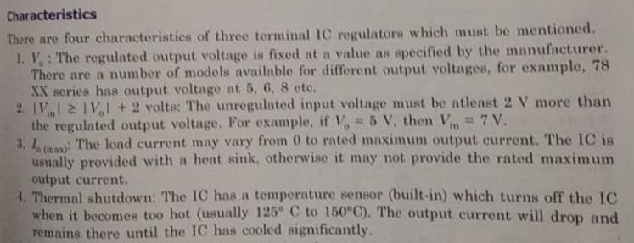
Characteristics of 3 Terminal IC regulators

Slide 27
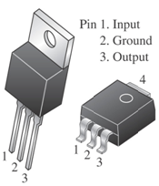
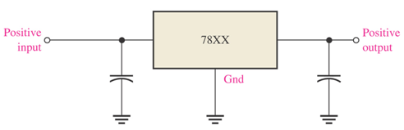
Fixed Voltage Regulator
The fixed voltage regulator has an unregulated dc input voltage V_{i} applied to one input terminal, a regulated output dc voltage V_{o} from a second terminal, and the third terminal connected to ground.
Fixed-Positive Voltage Regulator
The series 78XX regulators are the three-terminal devices that provide a fixed positive output voltage.

Slide 28
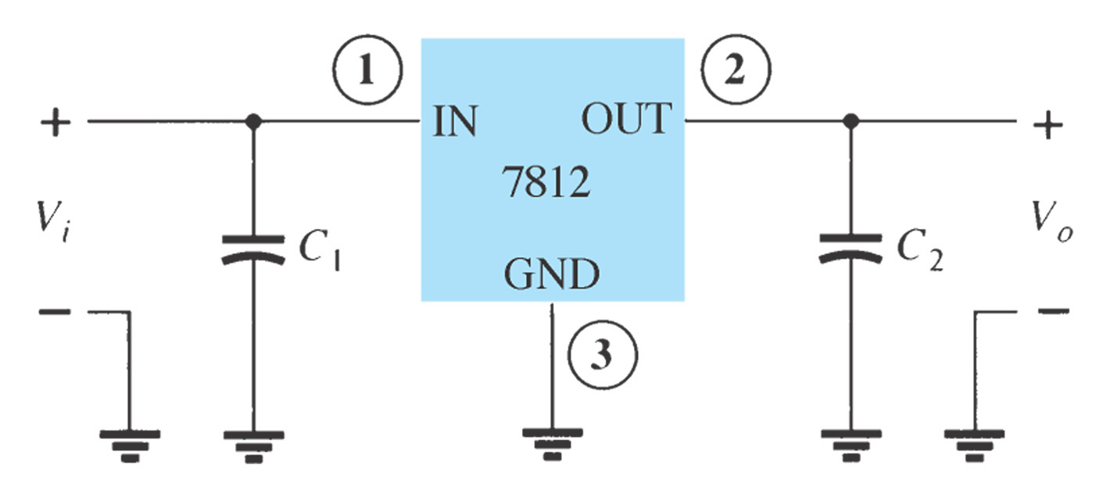
Fixed Voltage Regulator
An unregulated input voltage V_{i} is filtered by a capacitor C₁ and connected to the IC’s IN terminal.
The IC’s OUT terminal provides a regulated +12 V, which is filtered by capacitor C₂.
The third IC terminal is connected to ground (GND)

Slide 29
Fixed Voltage Regulator
Positive-Voltage Regulators in the 78XX Series
IC Part | Output Voltage (V) | Minimum V_{i} (V)
7805 | +5 | +7.3
7806 | +6 | +8.3
7808 | +8 | +10.5
7810 | +10 | +12.5
7812 | +12 | +14.5
7815 | +15 | +17.7
7818 | +18 | +21.0
7824 | +24 | +27.1

Slide 30
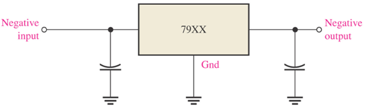
Fixed Voltage Regulator
Fixed-Negative Voltage Regulator
The series 79XX regulators are the three-terminal IC regulators that provide a fixed negative output voltage.
This series has the same features and characteristics as the series 78XX regulators except the pin numbers are different.

Slide 31
Fixed Voltage Regulator
Negative-Voltage Regulators in the 79XX Series
IC Part | Output Voltage (V) | Minimum V_{i} (V)
7905 | -5 | -7.3
7906 | -6 | -8.4
7908 | -8 | -10.5
7909 | -9 | -11.5
7912 | -12 | -14.6
7915 | -15 | -17.7
7918 | -18 | -20.8
7924 | -24 | -27.1

Slide 32
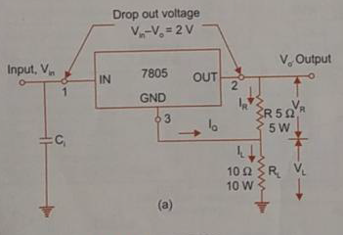

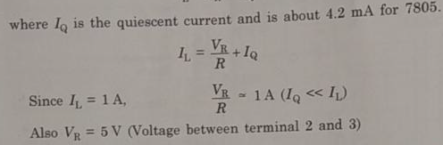

Voltage regulator as a current source

Slide 33
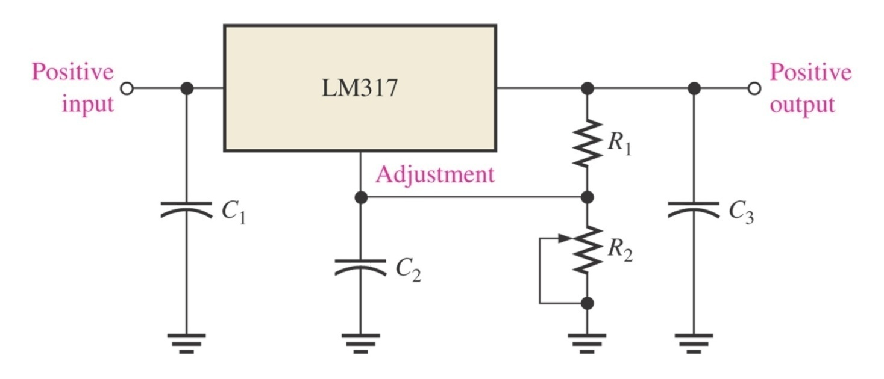
Adjustable-Voltage Regulator
Voltage regulators are also available in circuit configurations that allow to set the output voltage to a desired regulated value.
The LM317 is an example of an adjustable-voltage regulator, can be operated over the range of voltage from 1.2 to 37 V.
LM 117,217,317 - POSITIVE ADJUSTABLE REGULATOR
LM 137, 237,337 - NEGATIVE ADJUSTABLE REGULATOR

Slide 34
IC 723 Voltage Regulator- General Purpose Regulator
Limitations of 3 terminal regulators:
No short circuit protection
Output voltage is fixed
IC723 ----
Adjusted over a wide range of both
positive and negative regulated voltage
Low current device, but can able to provide 5A by connecting external components

Slide 35
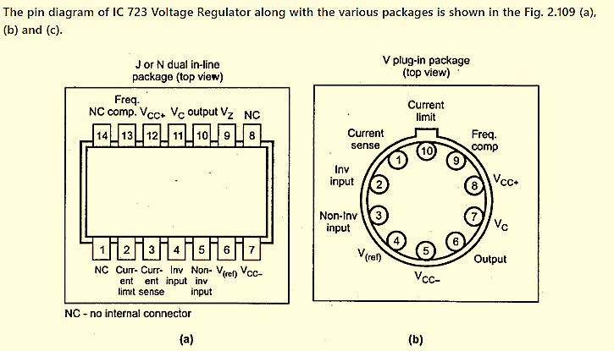
IC 723 Voltage Regulator
Features of IC 723:
It works as voltage regulator at output voltage ranging from 2 to 37 volts at currents upto 150 mA.
It can be used at load currents greater than 150 mA with use of suitable NPN or PNP external pass transistors.
Input and output short-circuit protection is provided.
It has good line and load regulation (0.03%)
Wide variety of applications of series, shunt, switching and floating regulator.
Low temperature drift and high ripple rejection.
Low standby current drain.
Small size, lower cost
Relative ease with which power supply can be designed.
It provides a choice of supply voltage.

Slide 36
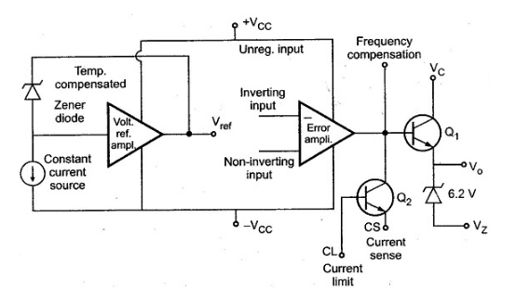
The functional block diagram of IC 723 Voltage Regulator can be divided into four major blocks
Temperature compensated voltage reference source, which is zener diode.
An op-amp circuit used as an error amplifier.
A series pass transistor capable of a 150 mA output current.
Transistor used to limit output current.

Slide 37
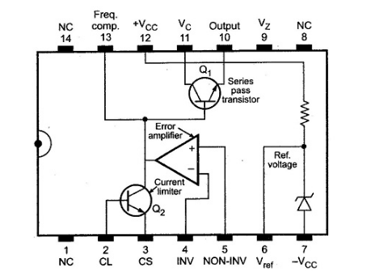
Pin Details

Slide 38
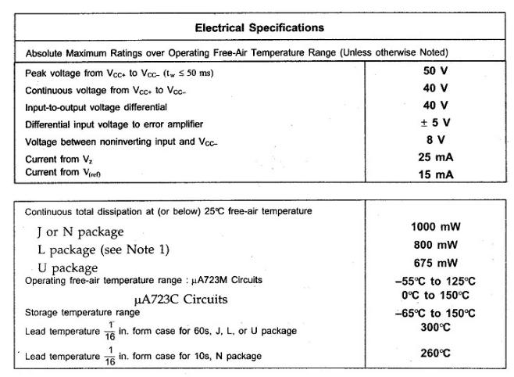
Specifications of IC Regulator 723:

Slide 39
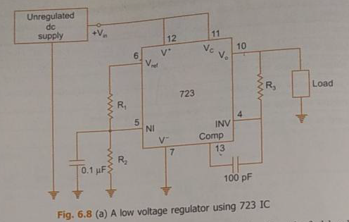

IC723 - low voltage regulator

Slide 40
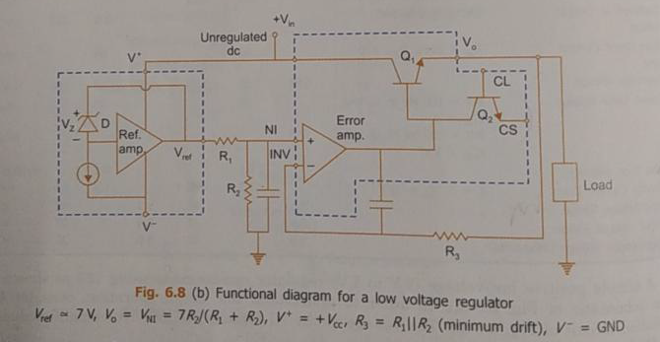
Functional Diagram of IC723 – low voltage regulator

Slide 41
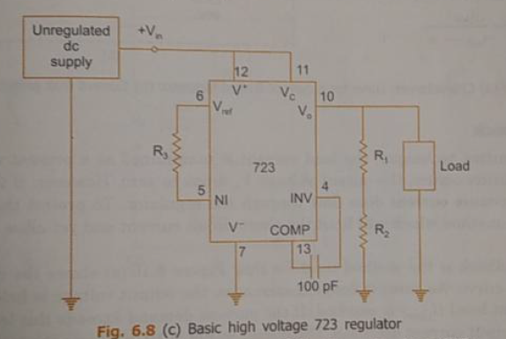
IC723 - High voltage regulator

Slide 42
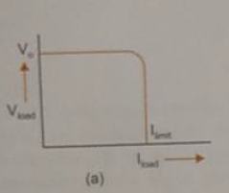
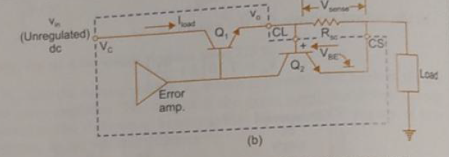
Current Limit Protection – IC723

Slide 43
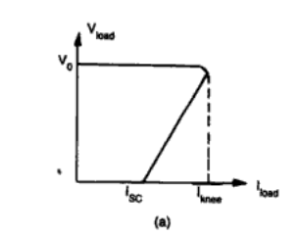
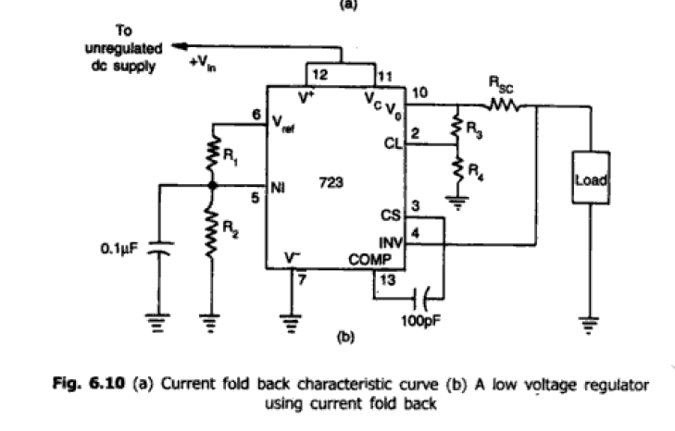
Current fold Method

Slide 44
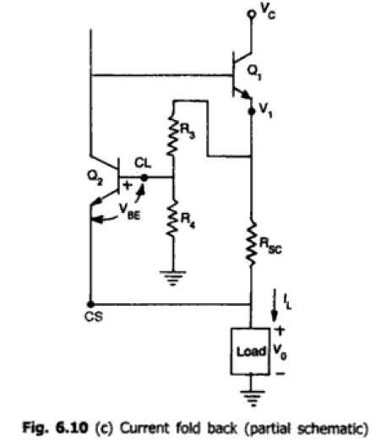

Slide 45
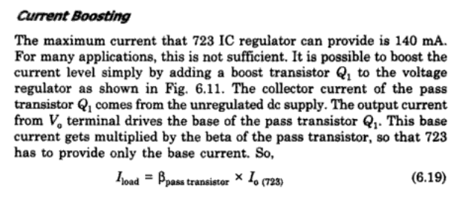
Current Boosting

Slide 46
